Slide 1
LEGAL CHATBOT ADVISORY SYSTEM BATCH-4 Team Members: Audhavan A 811721243010 Barathvaj M 811721243011 Mohamed Thabish M 811721243031 Vigneshwaran M 811721243061
Guide Name : Mrs.G.Nalina Keerthana ME

Slide 2
OBJECTIVE
The objective of creating a legal chatbot advisory system is to provide accessible, cost-effective, and accurate legal information to the public, thereby enhancing legal awareness and education. This system aims to streamline the process of obtaining legal advice, support legal professionals by handling preliminary queries, and guide users through initial legal procedures and document preparation.

Slide 3
EXISTING SYSTEM
• ROSS Intelligence: ROSS is a legal research platform that uses artificial intelligence to help lawyers find relevant case law and statutes. It also offers a chatbot interface for legal research queries.
• Do Not Pay: Do Not Pay started as a chatbot to help with parking ticket appeals but has expanded to offer legal advice in various areas, such as landlord-tenant disputes , consumer rights, and more.
• LexisNexis: LexisNexis offers legal research tools and services, including chatbot interfaces, to help legal professionals access relevant legal information and resources.
• IBM Watson Legal: IBM Watson offers AI-powered legal solutions, including chatbots, to assist with legal research, document analysis, and contract review.

Slide 4
PROPOSED SYSTEM
• Personalized Legal Advice: The chatbot will provide personalized legal advice based on the user's specific needs and circumstances.
• Legal Information Retrieval: LACS will be integrated with legal databases and knowledge bases to retrieve relevant legal information and resources.
• Case Law and Statutory Analysis: The chatbot will be capable of analyzing case law and statutes to provide informed legal opinions.

Slide 5
LITERATURE SURVEY
SI.NO | TITLE | AUTHOR NAME | YEAR | ALGORITHM USED | MERITS | DEMERITS
1. | Linear regression based machine learning algorithm | Zamora, M. C. | 2021 | Regressions,support vector machine ,random forest. | It aids exploratory data analysis. It can identify relationships between variables. It is relatively straightforward to implement. | Linear regression assumes that the relationship between the independent and dependent variables is linear. If this assumption is not met, the model may provide poor predictions.

Slide 6
LITERATURE SURVEY
SI.NO | TITLE | AUTHOR NAME | YEAR | ALGORITHM USED | MERITS | DEMERITS
2. | K-Nearest Neighbour using Machine Learning Algorithm | Jayapal.k | 2023 | k nearest neighbor algorithm(Machine learning). | KNN is easy to understand and implement, making it an excellent choice for beginners in machine learning. | KNN is an instance-based algorithm, it needs to store all training data, which can be memory-intensive for large datasets

Slide 7
LITERATURE SURVEY
SI.NO | TITLE | AUTHOR NAME | YEAR | ALGORITHM USED | MERITS | DEMERITS
3. | Support Vector Machine using Machine Learning Techniques | Dr. H. S. Behera | 2022 | Support Vector Machine (SVM), Data Mining, Artificial Neural Network(ANN) | Optimizing margins can help reduce the overfitting of data and allow for capacity control | SVM does not perform very well when the data set has more noise i.e. target classes are overlapping

Slide 8
LITERATURE SURVEY
SI.NO | TITLE | AUTHOR NAME | YEAR | ALGORITHM USED | MERITS | DEMERITS
4. | Artificial Neural Network(ANN) using Machine Learning Techniques | Sai Varun Nuna | 2012 | Artificial Neural Network(ANN),Data Mining. | Artificial neural networks have the ability to perform multiple functions simultaneously. | The functioning of the ANNs is not clear, and the solutions reached do not come with explanations as to how or why they were reached.

Slide 9
LITERATURE SURVEY
SI.NO | TITLE | AUTHOR NAME | YEAR | ALGORITHM USED | MERITS | DEMERITS
5. | Decision Tree using machine learning and IOT. | Sunil Kumar.K | 2023 | Decision Tree Learning, classification,Machine learning Model. | Decision trees are easy to interpret and visualize. The decision rules learned from the data can be easily understood by non-experts. | Decision trees are prone to overfitting, especially with deep tree that capture noise in the training data. This can lead to poor generalization to unseen data.

Slide 10
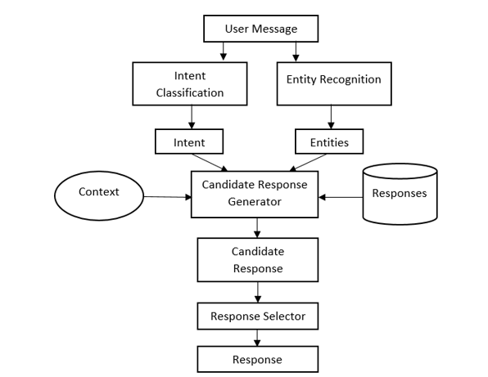
SYSTEM ARCHITECTURE

Slide 11
SYSTEM SPECIFICATION
HARDWARE SPECIFICATION :
Computer - minimum of 4GB RAM & dual-core processor.
MOBcam - at least 720p & high frame rate of at least 30fps.
Stable internet connection.
Storage.
SOFTWARE SPECIFICATION :
Python programming language - Python 3.x installed on the computer .
Operating system – Windows.
Python libraries such as – NumPy , pandas, tensor flow, SciPy, pillow.
HTML/CSS or JavaScript - for UI design

Slide 12
MODULES
User Interface Module
Natural Language Processing (NLP) Module
Knowledge Base Module
Legal Information Retrieval Module
User Query Processing Module
Authentication and Authorization Module
Backend and API Module
Analytics and Feedback Module
Deployment Module

Slide 13
USER INTERFACE MODULE
Purpose: Facilitate user interaction with the chatbot.
Components:
Chat interface (web, mobile)
Input fields for user queries
Display areas for chatbot responses

Slide 14
NATURAL LANGUAGE PROCESSING MODULE(NLP)
Purpose: Understand and process user inputs.
Components:
Intent recognition (understanding user queries)
Entity recognition (extracting relevant legal terms, names, dates)
Language understanding and response generation

Slide 15
KNOWLEDGE BASE MODULE
Purpose: Store and retrieve legal information and FAQs.
Components:
Structured databases of legal information
Predefined responses for common legal questions
Legal document templates and guides

Slide 16
LEGAL INFORMATION RETRIEVAL MODULE:
Purpose: Access and fetch up-to-date legal information from external sources.
Components:
Integration with legal databases (e.g., Westlaw, LexisNexis)
APIs for accessing public legal repositories

Slide 17
USER QUERY PROCESSING MODULE:
Purpose: Process user queries and generate appropriate responses.
Components:
Query classification (categorizing types of legal questions)
Context management (maintaining context across multiple interactions)
Response generation (providing accurate and relevant answers)

Slide 18
AUTHENTICATION AND AUTHERIZATION MODULE
Authentication and Authorization Module
Purpose: Secure user access and data.
Components:
User authentication (login, registration)
Role-based access control (different access levels for users, admins, etc.)
Data encryption and privacy measures

Slide 19
BACKEND AND API MODULE
Purpose: Manage communication between the front end, NLP module, and knowledge base.
Components:
API Gateway (handling requests and responses)
Server-side logic and processing
Database management for user data and interactions

Slide 20
ANALYTICS AND FEEDBACK MODULE
Purpose: Monitor chatbot performance and gather user feedback.
Components:
Usage analytics (tracking interactions, common queries)
Feedback collection (user ratings, comments)
Continuous improvement based on analytics and feedback

Slide 21
DEPLOYMENT MODULE:
Purpose:
The Deployment Module ensures that the legal chatbot advisory system is accessible, reliable, scalable, and secure. It handles the deployment, management, and maintenance of the system in production environments.
Components:
Infrastructure setup
Continous Integration/Continous Deployment
Containerization and Orchestration
Monitoring and Logging
Security Management
Scalability and Load Balancing
Disaster Recovery
User Feedback and Analytics

Slide 22
ADVANTAGES
Automated Routine Tasks
24/7 Availability
Initial Client Screening
Use friendly
Cost effectiveness
Accessiblity
Scalability

Slide 23
APPLICATIONS
1. Client Onboarding and Support:
Initial Consultation
FAQ Handling
2. Document Automation and Review:
Document Drafting
Document Review

Slide 24
CONCLUSION
In conclusion, the development of an AI-driven Legal Advisory Chatbot System (LACS) has the potential to revolutionize the legal advisory landscape. By leveraging state-of-the-art natural language processing (NLP) and machine learning algorithms, LACS can provide personalized legal advice , access to legal resources, and case law analysis in a user-friendly and accessible manner.

